Slide 1


APPLICATION CHEMISTRY
A2 LEVEL
MATERIALS AND DESIGN
CHAPTER 1:
MEDICINAL CHEMISTRY & DRUG DELIVERY

Slide 2
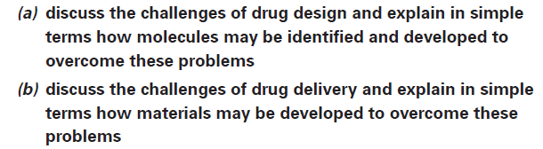
What you should know…

Slide 3
Medicinal Chemistry and Drug Delivery
Development in the last century of antibiotics, transplant surgery and many other life-saving advances have transformed the way we live.
Two of the ways in which chemists are trying to combat disease:
Developing and synthesising new drugs to target specific diseases.
One way of doing this is to start from natural products – molecules that are synthesised by plants and other organisms - that have been shown to have beneficial effects, for example, the drug Taxol®,found in yew tree barks and leaves.
Taxol® has been found to be effective against some cancers.

Slide 4
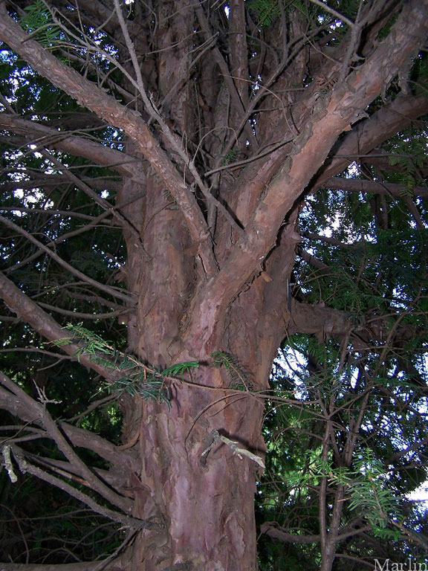

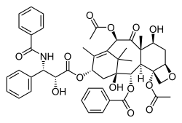

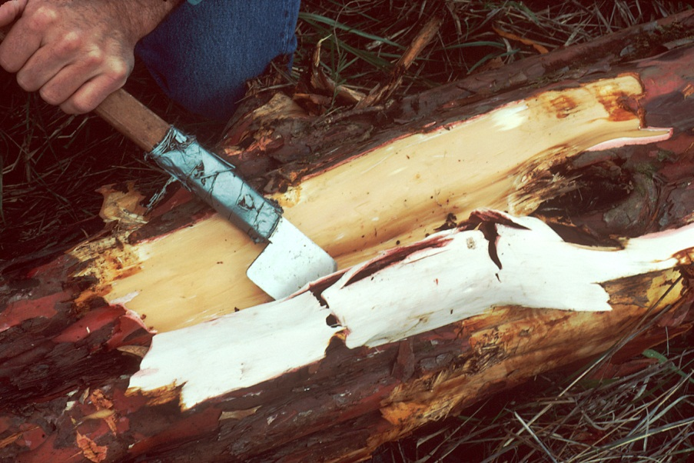

Slide 5
Medicinal Chemistry and Drug Delivery
Secondly, chemists are investigating means of getting drugs to the specific part of the body where they need to act.
Such methods can reduce side effects and the quantities of drugs needed.
One involves liposomes, where, in effect, the drug is delivered in a “bag” to the diseased body site.

Slide 6
Designing drugs
When a molecule is to be used as a drug it is important that it is effective in achieving its desired effect and that undesirable side effects are avoided.
Thalidomide was, at this time(1960s), the preferred sedative during pregnancy as the alternatives, such as Valium, were addictive.
At that time the thalidomide produced was a mixture of two optical isomers.
Unfortunately one of the isomers of thalidomide proved to have disastrous side-effects, causing babies to be born with congenital deformities such as shortened limbs

Slide 7
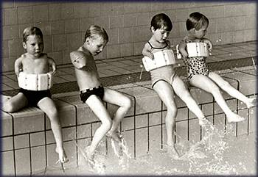
Thalidomide first appeared in Germany on 1st October 1957.
It was marketed as a sedative with apparently remarkably few side effects.
The Drug Company who developed it believed it was so safe it was suitable for prescribing to pregnant women to help combat morning sickness.

Slide 8
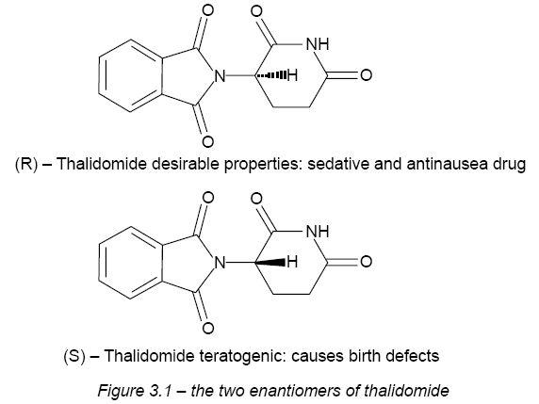
Designing drugs

Slide 9
Designing drugs
Drug molecules act by binding to receptors, and in many cases these receptors are enzymes.
Drugs can be competitive inhibitors of enzymes and if a drug has optical isomers, only the isomer that is complementary to the shape of the enzyme active site will fit.
In order to bind to its receptor a drug must not only have the shape to fit, but must also be able to interact with the groups on the receptor molecule by hydrogen bonds, ionic interactions or dipole-dipole interactions.

Slide 10
Designing drugs
Computational methods have proved very powerful both in designing new medicines and in understanding how drugs act.
Chemists seek a route that produces only the active molecule that is desired. This process is called asymmetric synthesis.
A key reason for this change is that when two chiral molecules are produced, they are produced in equal quantities, so half of the reactants are wasted.
Asymmetric synthesis therefore saves on resources and costs.

Slide 11
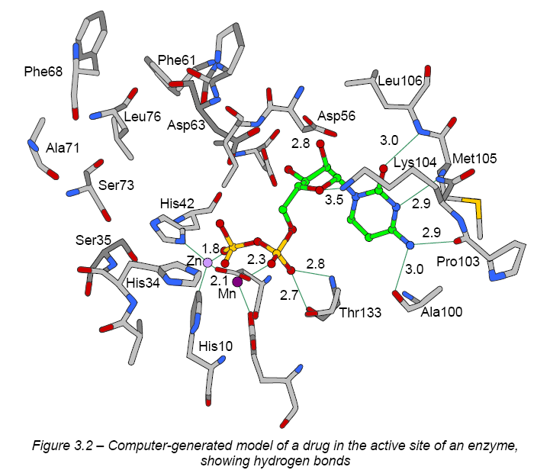

Slide 12
Designing drugs
A successful example of asymmetric synthesis is in the treatment of Parkinson’s disease.
a molecule called L-dopa (the L enantiomer of dopa) can alleviate the symptoms.
The L-dopa must be free of D-dopa, as the latter has many unpleasant side effects. Chemists now make pure L-dopa for use by patients.
These changes alone would not have had an effect on the thalidomide story, as the molecule can switch between enantiomers at the pH of the blood.

Slide 13
Designing drugs
Seeking a new pharmaceutical - start from a natural product molecule
Recent example - anticancer drug Taxol®
Taxol® is found in yew trees. It acts by binding to protein molecules in the cell and preventing the cell from dividing.
Only small amounts of Taxol® can be isolated from yew trees, so it became important to find ways of synthesising Taxol®.

Slide 14
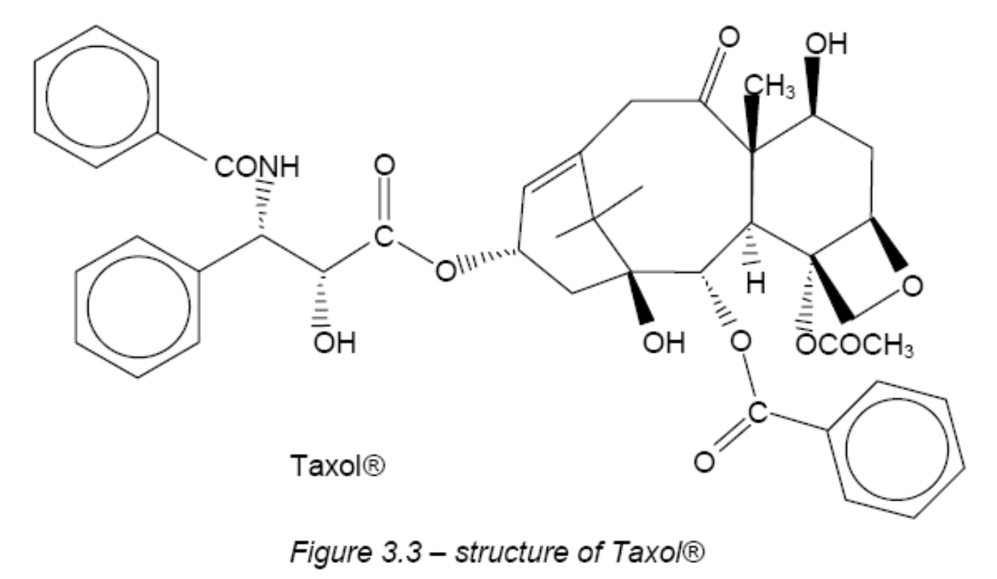
Designing drugs

Slide 15
Designing drugs
Synthesising a molecule as large and complex as Taxol® is a major challenge
To do this requires chemists to firstly, know the structure of the Taxol®, and then work out ways of making the drug.
The structures of such molecules can be worked out by the NMR and X-ray techniques

Slide 16
Designing drugs
The first groups achieved their goal in 1994, but research continues as chemists are keen to minimise the number of reactions needed.
Keen to make similar molecules with slightly different shapes and functional groups in order to try and find a molecule that is even more effective with fewer side effects.

Slide 17
Designing drugs
Get the drug molecule to that target site. This process is termed “drug delivery”.
There are many problems with delivering drugs, one of which is how to get the drug to its target in one piece and avoid it being broken down by enzymes or degrading in extremes of pH.
One successful method of delivery involves the use of liposomes. These are artificial microscopic vesicles consisting of an aqueous core enclosed in one or more phospholipid layers.

Slide 18
Designing drugs
A phospholipid is a molecule that is hydrophilic (water-loving) at one end and hydrophobic (water-hating) at the other end.
In water-based solutions such as blood, lipids group together to form double layers with their hydrophilic groups on the outside, forming polar interactions with the water, and their hydrophobic groups on the inside, away from the water.

Slide 19
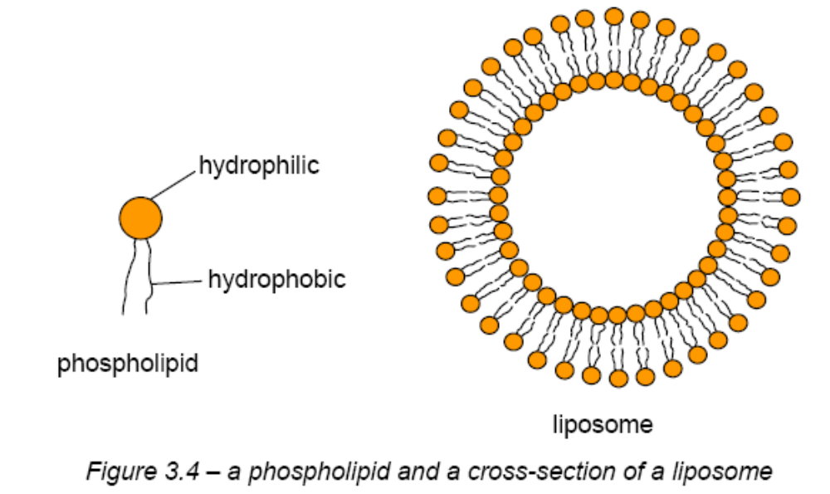
Designing drugs

Slide 20
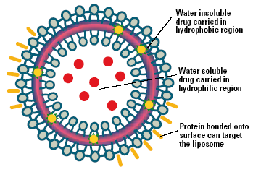
A liposome encapsulates a region of aqueous solution inside a hydrophobic membrane; dissolved hydrophilic solutes cannot readily pass through the lipids.
Hydrophobic chemicals can be dissolved into the membrane, and in this way liposome can carry both hydrophobic molecules and hydrophilic molecules.
To deliver the molecules to sites of action, the lipid bilayer can fuse with other bilayers such as the cell membrane, thus delivering the liposome contents.

Slide 21
Designing drugs
Liposomes are biodegradable and non-toxic and can be used to carry vaccines, drugs, enzymes, or other substances to target cells or organs.
They can carry both hydrophilic molecules (polar molecules that form hydrogen bonds with water and hence dissolve) and hydrophobic molecules (non-polar molecules that do not dissolve in water).

Slide 22
Designing drugs
Modifying surface of liposomes biochemists have developed long-circulating liposomes, which do not degrade quickly and have a better chance of reaching their target.
Once the liposome reaches its target, the drug will be transferred to the target.

Slide 23
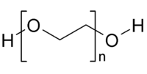
Designing drugs
A second method of protecting drugs while they are circulating in the bloodstream is to attach them to polymers.
A popular polymer to use is polyethylene glycol, or PEG.

Slide 24
Designing drugs
PEG is soluble in water
Disadvantage of PEG compared with a liposome is that it can only carry two drug molecules.
To improve the number of drug molecules that a polymer can deliver, different polymers can be made where some of the monomers have side chains that can link to the drug molecules.

